Slide 1
AGARPATHI + HANGYO
Designer vs Automated

Slide 2
What was fixed in this round
Found by comparing every board with the designer's own picture; each fix was checked on the real boards in CorelDRAW
Hangyo
- Tamil name ran past the white panel on the 10x3 boards - names are now held inside the panel, in two lines like hers
- Names on the wide boards (16 - 26 ft) were 30-40 % smaller than hers - the panel takes the width of the designer's board of that size and the names fill it
- English names are set in capitals and wrapped to HER line count (KARTHIKEYAN / STORE); they no longer run into the pictures at the panel corners or off the bottom
- Wrapped names break where she breaks them (Asian / Juice Bar, not Asian Juice / Bar)
- Tamil on the 8x3 GSB boards was stretched to twice its width and touched the English name - fixed
- The second logo is drawn on the 10x4 GSB and 8x3 GSB boards, where she repeats it
Agarpathi
- 13x2, 10x3 and 5x5 ft boards: English and Tamil names were printed on top of each other - each line keeps its own place
- 13x2 ft: the Sugandha Swarna logo is back in the right place and size
- 6x4 ft: the Tamil name no longer runs under the Black Stone pack picture
- Library rebuilt from all 62 designer files - 22 boards gained their English name box
Both brands
- NEW automatic name check on every generated board (app/name_check.py): a name off the page, on top of another name or under a picture is flagged. All 34 boards in this deck pass it
- Name sizes, line counts, panel widths and picture clearance are data / generic rules, not per-brand code
- 964 backend tests and 269 frontend tests pass (backend baseline 939 + new tests for each fix)

Slide 3
What is still different from the designer
Honest list - none of these crash or break a board, they are look-and-feel differences
Cannot be done from the master
- Agarpathi 35x4 ft (score 0.83): the designer added a maroon centre panel and a second picture set that the master does not contain - needs a master of that design
- Hangyo 3x6 ft portrait boards still use the plain layout (the 4 X 8 master matches no designer element); not part of this comparison
Approximations
- Hangyo 20x4 ft PERUMAL STORE (score 0.86): her name block is taller (two big Tamil lines), ours keeps the Tamil on one line
- Hangyo 26x3 and 16x3: our English line is a little smaller than hers so it stays between the pictures
- Names the designer retyped (SHIVANI STORE for Sivani Maligai) follow the shop sheet, not the engine
- The similarity score compares whole pictures and hardly moves when only a name changes - use the name check and the slides
Not tested yet
- Sizes the designer never made (a new size is a guess from the nearest board)
- Dalmia and Agni through the example library

Slide 4
Hangyo - at a glance
22 boards: boards the designers made, regenerated by the app with the final code (designer Tamil names from her files)
6/22
15/22
1/22
0/22
Very close
Close
Different
Wrong proportions
pixel similarity 95 % or more
88-95 % similar
under 88 % similar - layout or text differs
aspect ratio differs from the designer's by more than 5 %
How it is measured
Each automated picture is paired with the designer's JPEG of the same S.No, size and shop. Similarity = 1 - mean grey-level difference of both pictures at the same reduced size (average 0.93). It rates the whole picture, so a different shop name or a small shift barely moves it - look at the slides.
Proportions are compared from the pixel size of each picture.
Name check (a name off the page, on top of another name or under a picture): 22 of 22 boards clean

Slide 5


S.No 1
Asian Juice bar
16 X 3 Feet - Frontlit
CLOSE (89 %)
Name check: OK
DESIGNER
AUTOMATED

Slide 6


S.No 3
Shenbagam Enterprises ( Jothi maligai)
4 X 8 Feet - Nonlit
VERY CLOSE (98 %)
Name check: OK
DESIGNER
AUTOMATED

Slide 7


S.No 4
Lakshmi Store
10 X 3 Feet - Nonlit
CLOSE (91 %)
Name check: OK
DESIGNER
AUTOMATED

Slide 8


S.No 8
Sri Ganesha Kitchen
26 X 3 Feet - Frontlit
CLOSE (90 %)
Name check: OK
DESIGNER
AUTOMATED

Slide 9


S.No 10
Jeeva hotel
20 X 4 Feet - Frontlit
CLOSE (92 %)
Name check: OK
DESIGNER
AUTOMATED

Slide 10


S.No 14
New Sri happy Iyengar bakery
8 X 4 Feet - GSB
VERY CLOSE (96 %)
Name check: OK
DESIGNER
AUTOMATED

Slide 11
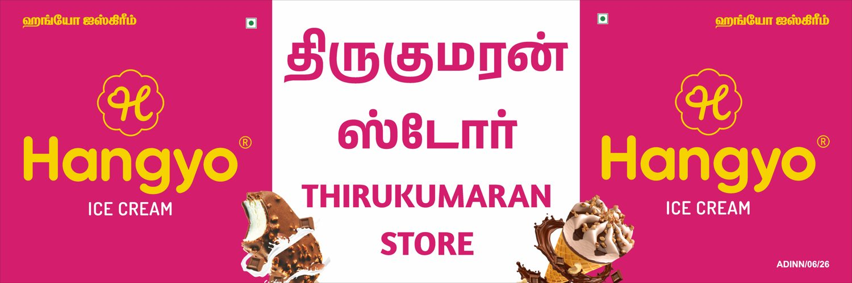
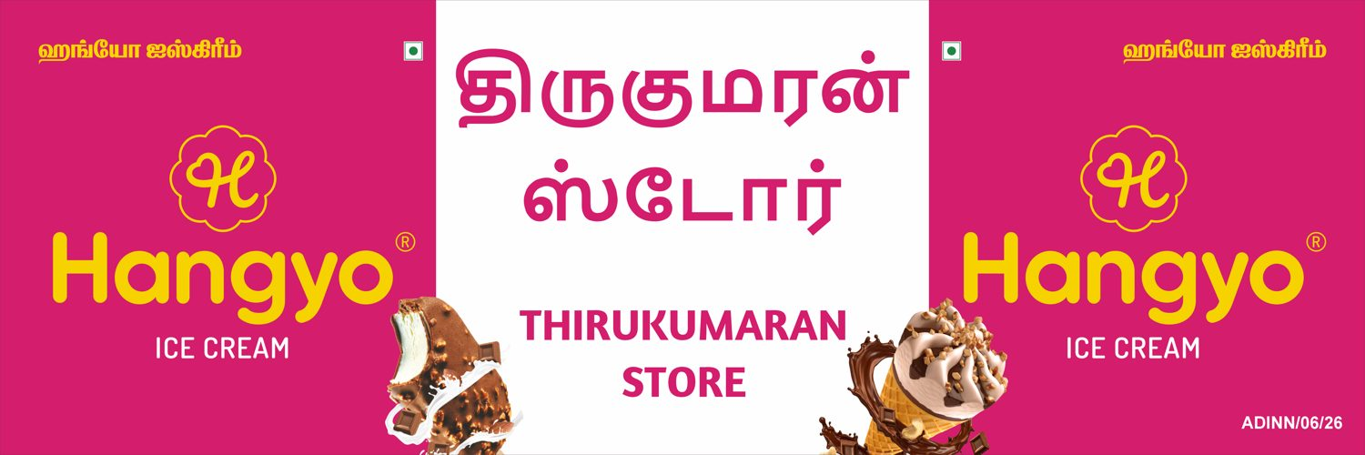
S.No 17
Thirukumaran store
12 X 4 Feet - Nonlit
CLOSE (92 %)
Name check: OK
DESIGNER
AUTOMATED

Slide 12


S.No 18
Udhayam cold drinks arthavadi
10 X 4 Feet - GSB
VERY CLOSE (97 %)
Name check: OK
DESIGNER
AUTOMATED

Slide 13


S.No 19
Sivani Maligai
10 X 3 Feet - GSB
CLOSE (92 %)
Name check: OK
DESIGNER
AUTOMATED

Slide 14


S.No 20
Sri thanga Vilas soda factory
8 X 3 Feet - GSB
VERY CLOSE (97 %)
Name check: OK
DESIGNER
AUTOMATED

Slide 15


S.No 21
Paramasivam store
8 X 3 Feet - GSB
VERY CLOSE (97 %)
Name check: OK
DESIGNER
AUTOMATED

Slide 16


S.No 22
Bengaluru bakery
20 X 3 Feet - Frontlit
CLOSE (90 %)
Name check: OK
DESIGNER
AUTOMATED

Slide 17


S.No 23
Guru tea stall
10 X 3 Feet - Frontlit
CLOSE (93 %)
Name check: OK
DESIGNER
AUTOMATED

Slide 18


S.No 24
PERUMAL STORE
20 X 4 Feet - Frontlit
DIFFERENT (86 %)
Name check: OK
DESIGNER
AUTOMATED

Slide 19


S.No 25
Karthikeyan store
10 X 3 Feet - GSB
CLOSE (95 %)
Name check: OK
DESIGNER
AUTOMATED

Slide 20


S.No 25
Karthikeyan store
20 X 3 Feet - Frontlit
CLOSE (90 %)
Name check: OK
DESIGNER
AUTOMATED

Slide 21


S.No 26
Om guru sweets & bakery
20 X 3 Feet - GSB
CLOSE (90 %)
Name check: OK
DESIGNER
AUTOMATED

Slide 22


S.No 27
Jairam maligai
20 X 4 Feet - Nonlit
CLOSE (89 %)
Name check: OK
DESIGNER
AUTOMATED

Slide 23


S.No 28
Sekar store
10 X 3 Feet - Nonlit
CLOSE (94 %)
Name check: OK
DESIGNER
AUTOMATED

Slide 24


S.No 29
Hotel dhanalakshmi Vilas
15 X 3 Feet - GSB
CLOSE (91 %)
Name check: OK
DESIGNER
AUTOMATED

Slide 25


S.No 30
Arulmoli maligai & bakery
10 X 3 Feet - Frotlit
VERY CLOSE (96 %)
Name check: OK
DESIGNER
AUTOMATED

Slide 26


S.No 31
Kanish Cool Drink's
10 X 3 Feet - GSB
CLOSE (94 %)
Name check: OK
DESIGNER
AUTOMATED

Slide 27
Agarpathi - at a glance
12 boards: boards the designers made, regenerated by the app with the final code (designer Tamil names from her files)
10/12
1/12
1/12
0/12
Very close
Close
Different
Wrong proportions
pixel similarity 95 % or more
88-95 % similar
under 88 % similar - layout or text differs
aspect ratio differs from the designer's by more than 5 %
How it is measured
Each automated picture is paired with the designer's JPEG of the same S.No, size and shop. Similarity = 1 - mean grey-level difference of both pictures at the same reduced size (average 0.96). It rates the whole picture, so a different shop name or a small shift barely moves it - look at the slides.
Proportions are compared from the pixel size of each picture.
Name check (a name off the page, on top of another name or under a picture): 12 of 12 boards clean

Slide 28
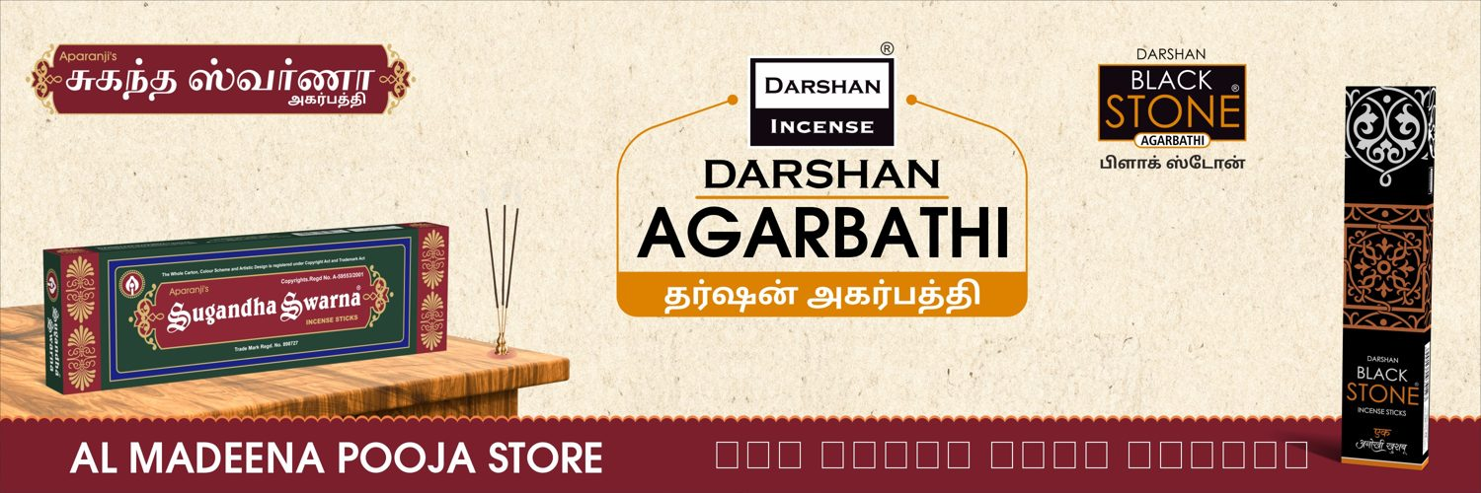
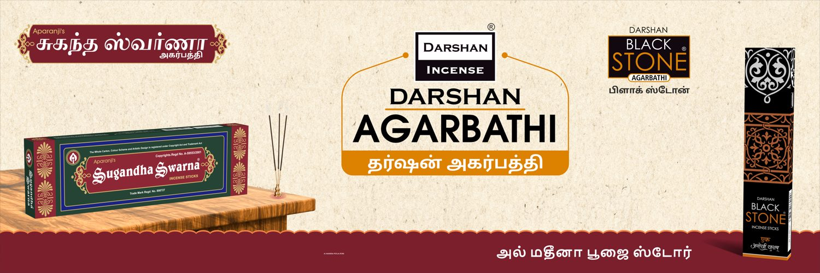
S.No 16
AL MADEENA POOJA STORE
12 X 4 Feet - Nonlit
VERY CLOSE (98 %)
Name check: OK
DESIGNER
AUTOMATED

Slide 29
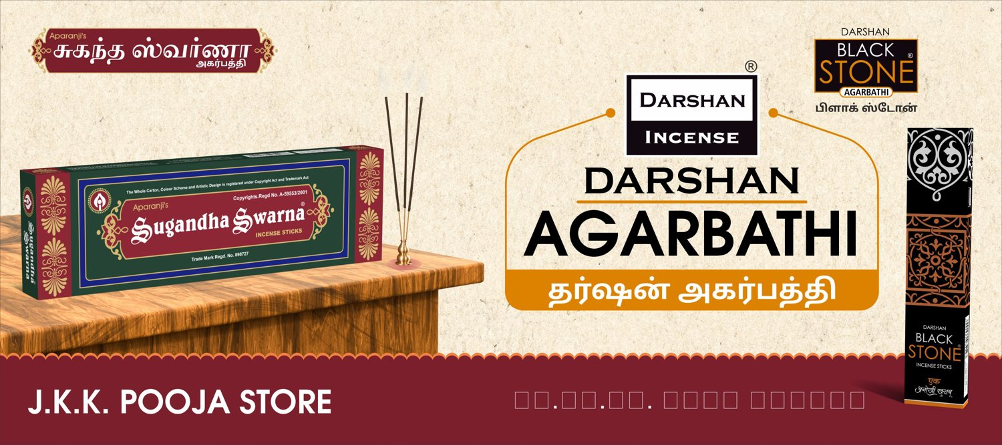
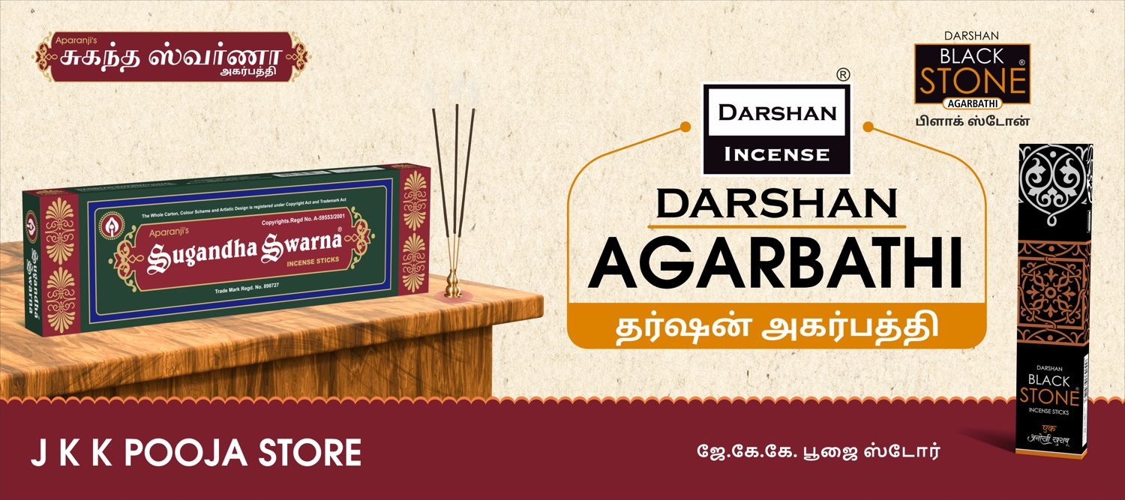
S.No 17
J K K POOJA STORE
9 X 4 Feet - Nonlit
VERY CLOSE (98 %)
Name check: OK
DESIGNER
AUTOMATED

Slide 30
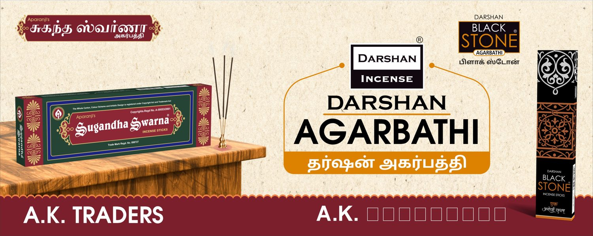

S.No 18
A K TRADERS
10 X 4 Feet - Nonlit
VERY CLOSE (99 %)
Name check: OK
DESIGNER
AUTOMATED

Slide 31
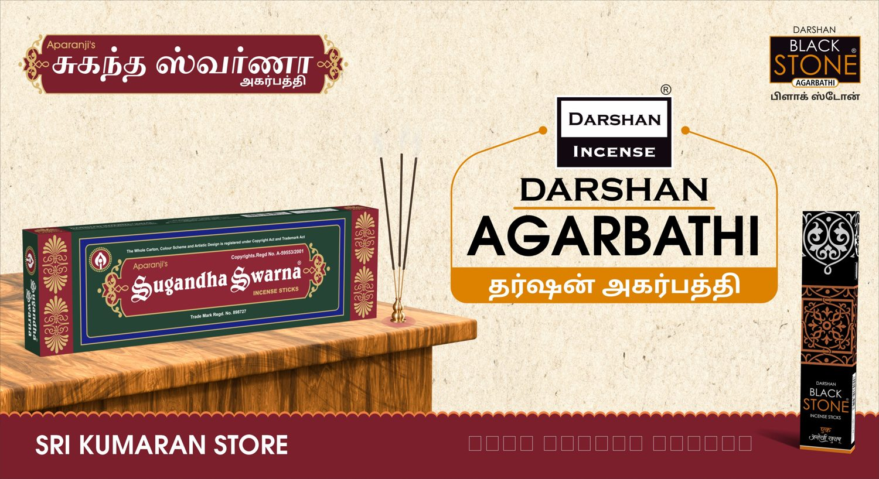
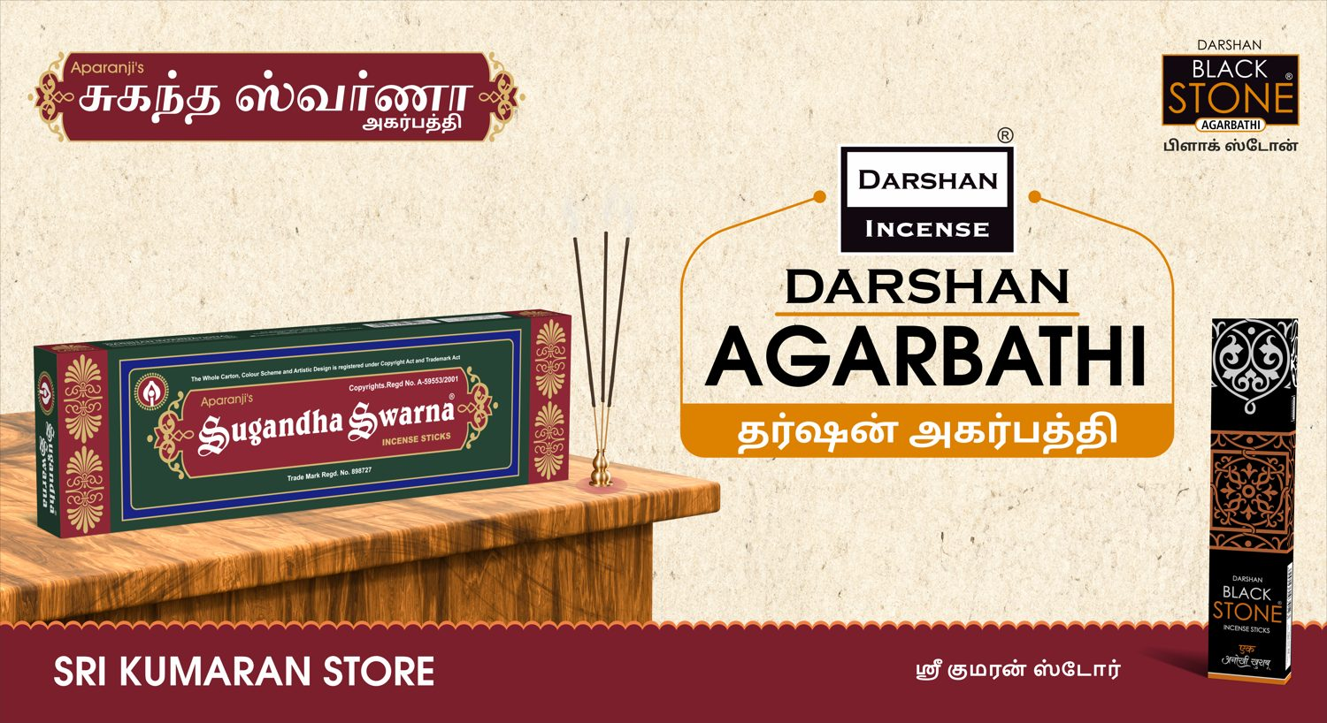
S.No 21
SRI KUMARAN STORE
11 X 6 Feet - Nonlit
VERY CLOSE (99 %)
Name check: OK
DESIGNER
AUTOMATED

Slide 32
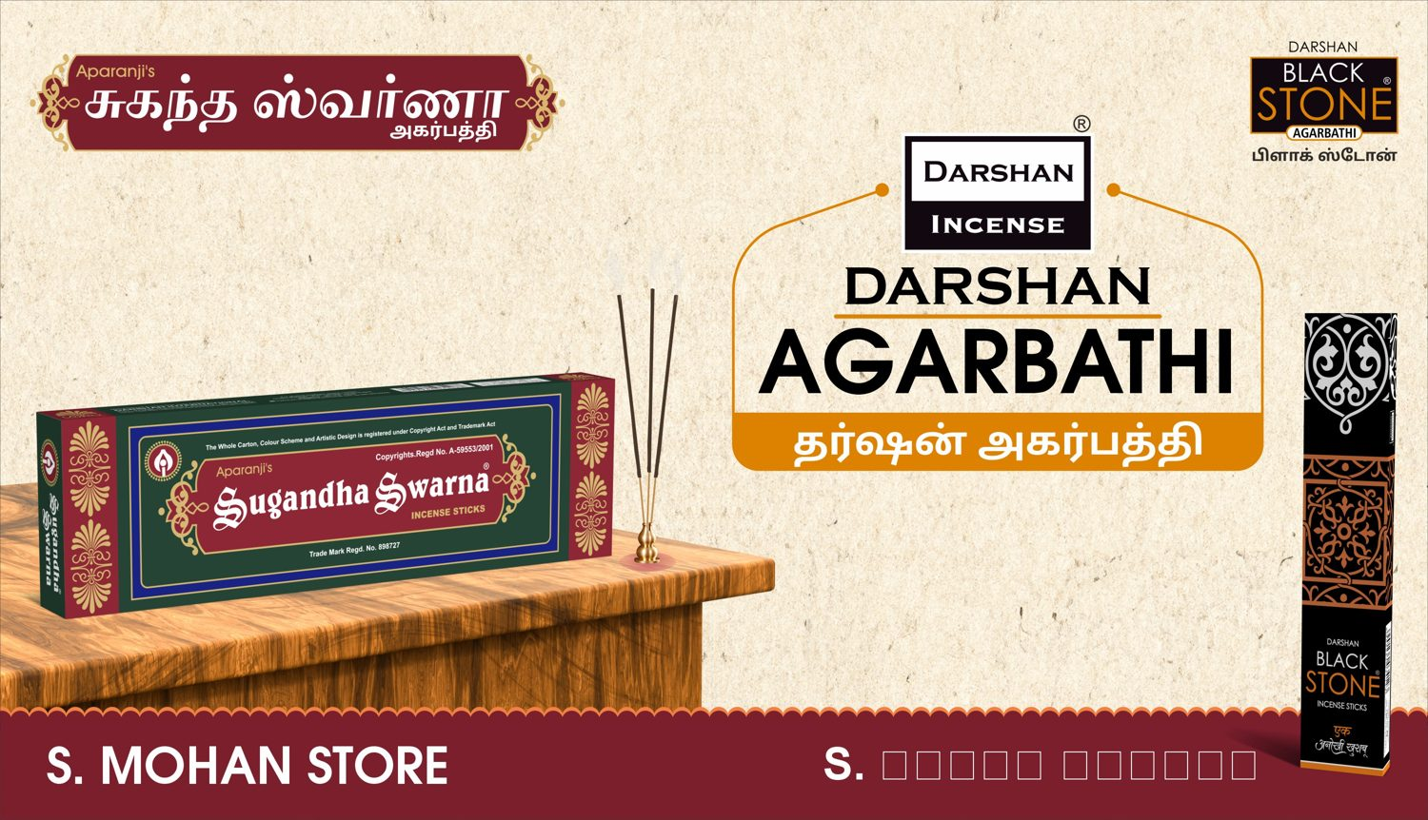

S.No 22
S. MOHAN STORE
94 X 54 Inch - Nonlit
VERY CLOSE (99 %)
Name check: OK
DESIGNER
AUTOMATED

Slide 33
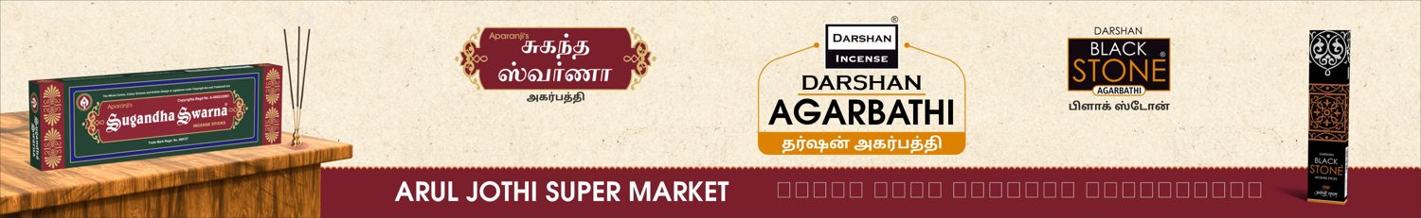
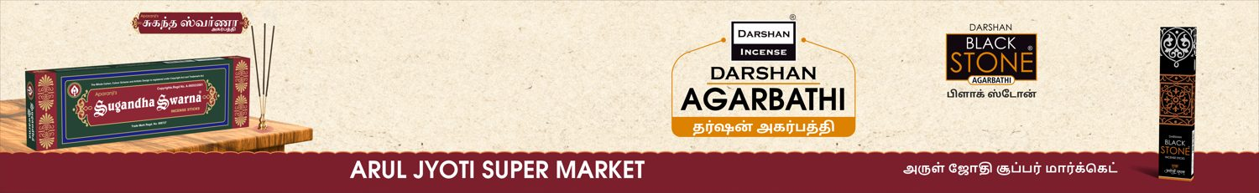
S.No 23
ARUL JYOTI SUPER MARKET
13 X 2 Feet - Nonlit
CLOSE (94 %)
Name check: OK
DESIGNER
AUTOMATED

Slide 34
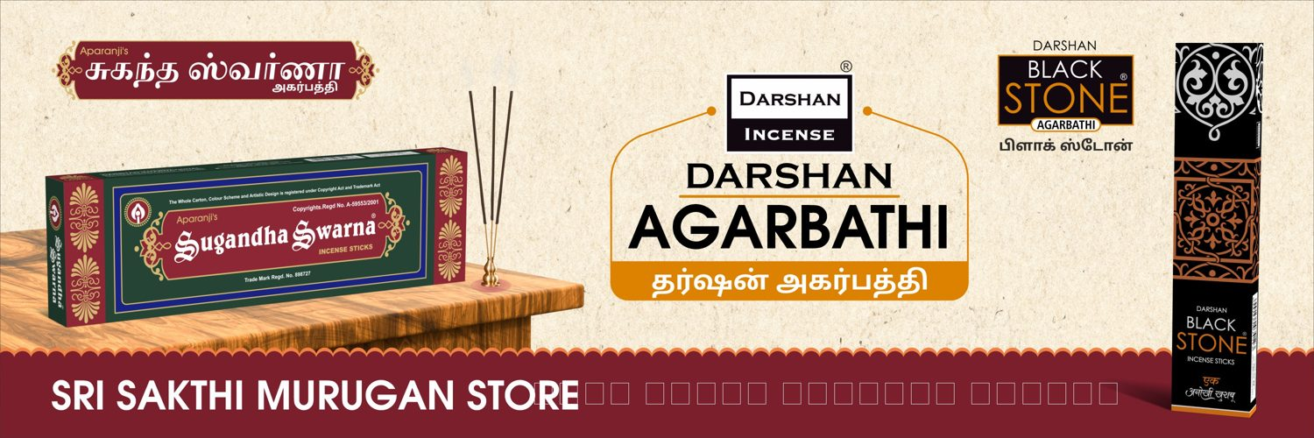
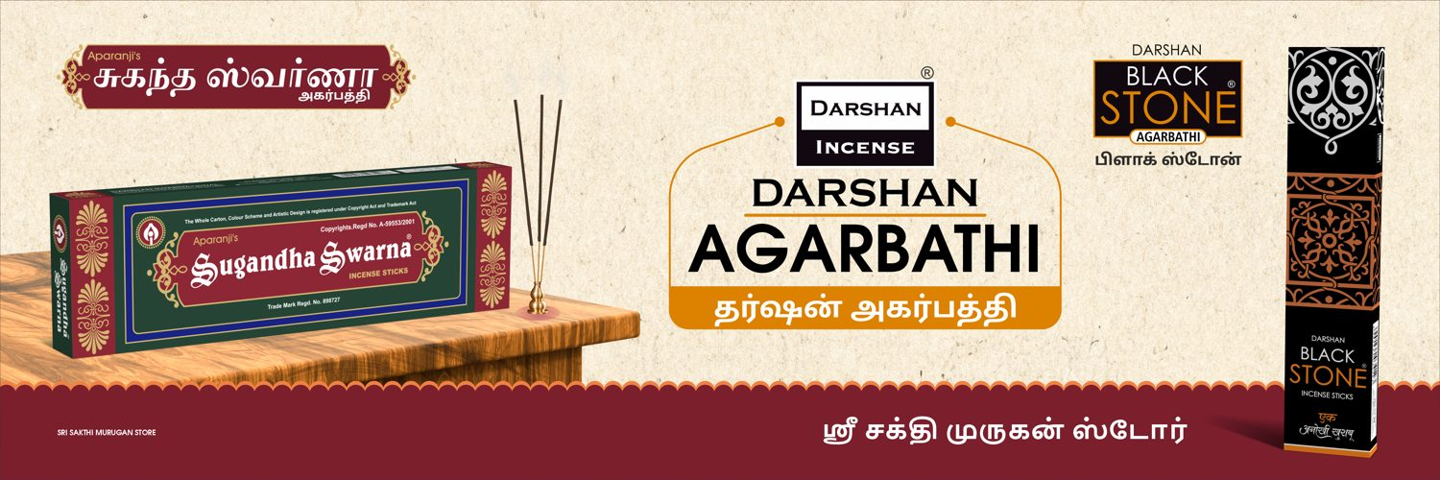
S.No 24
SRI SAKTHI MURUGAN STORE
9 X 3 Feet - Nonlit
VERY CLOSE (98 %)
Name check: OK
DESIGNER
AUTOMATED

Slide 35
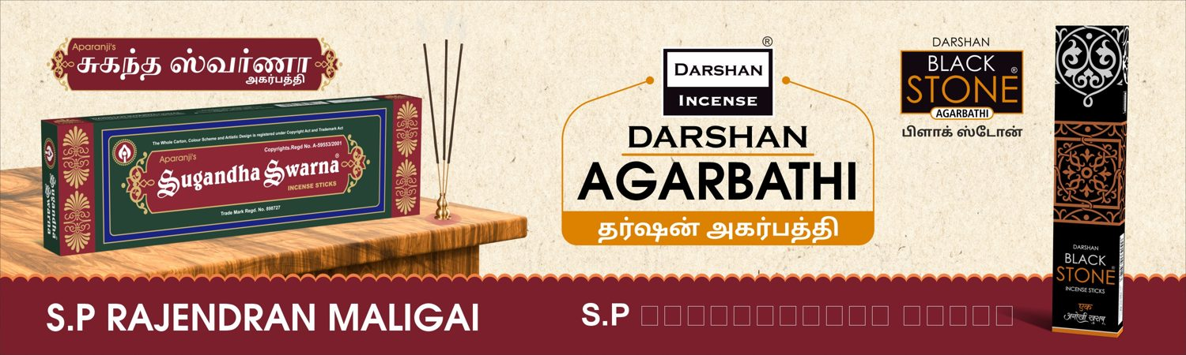
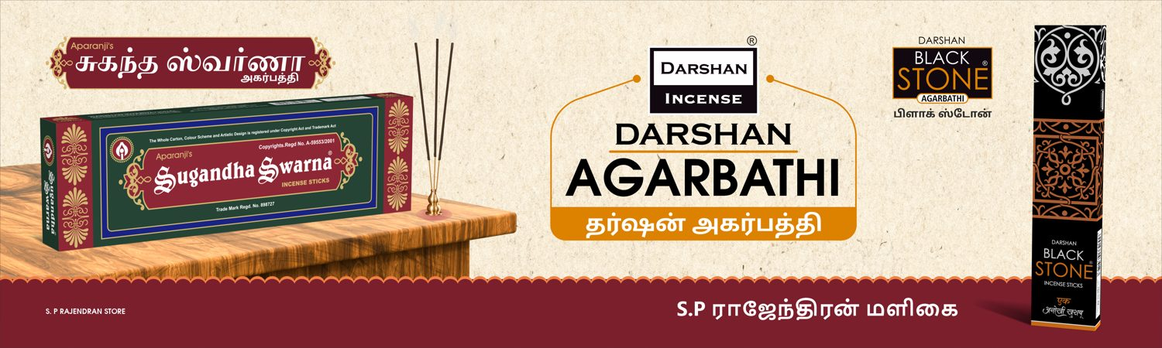
S.No 25
S. P RAJENDRAN STORE
10 X 3 Feet - Nonlit
VERY CLOSE (96 %)
Name check: OK
DESIGNER
AUTOMATED

Slide 36
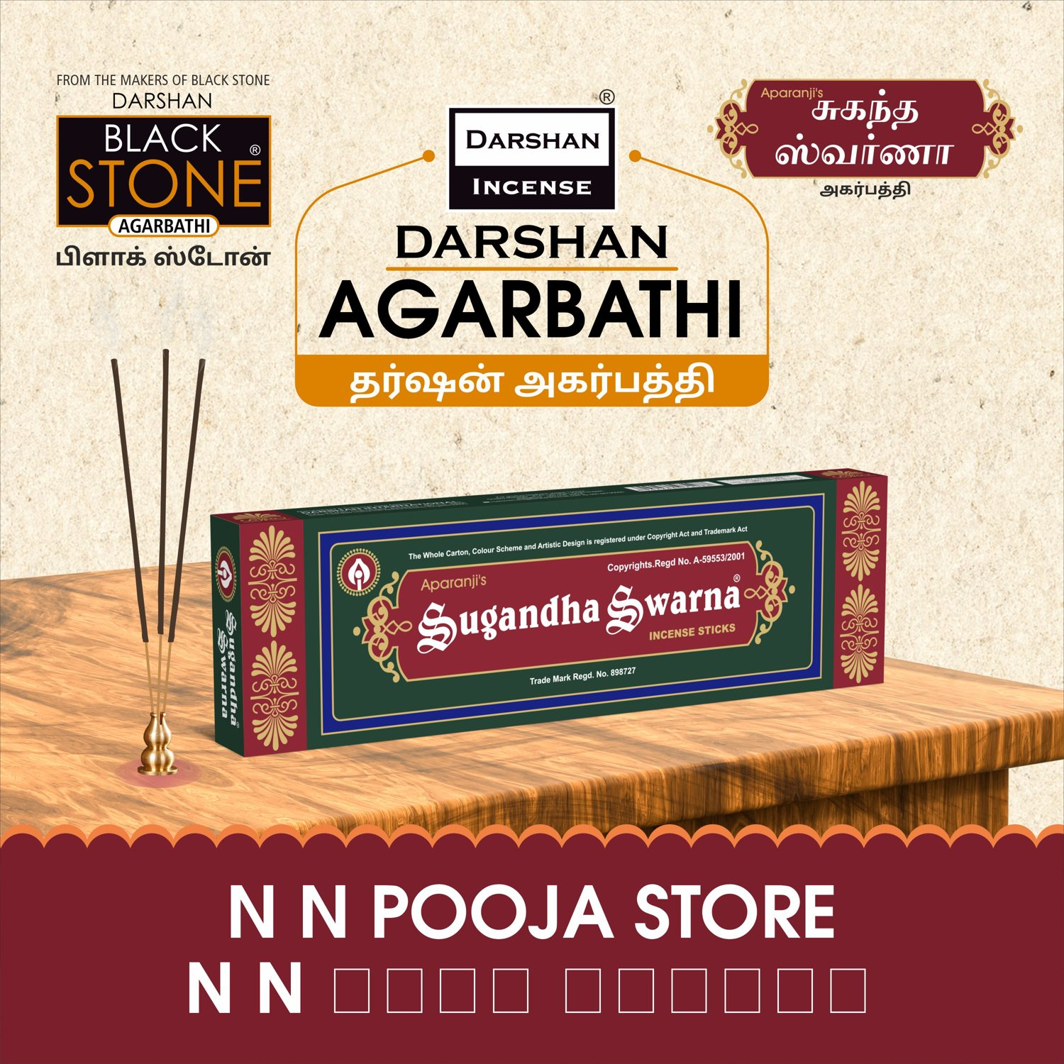

S.No 26
N N NATTU MARUNDHU KADAI
5 X 5 Feet - Nonlit
VERY CLOSE (96 %)
Name check: OK
DESIGNER
AUTOMATED

Slide 37
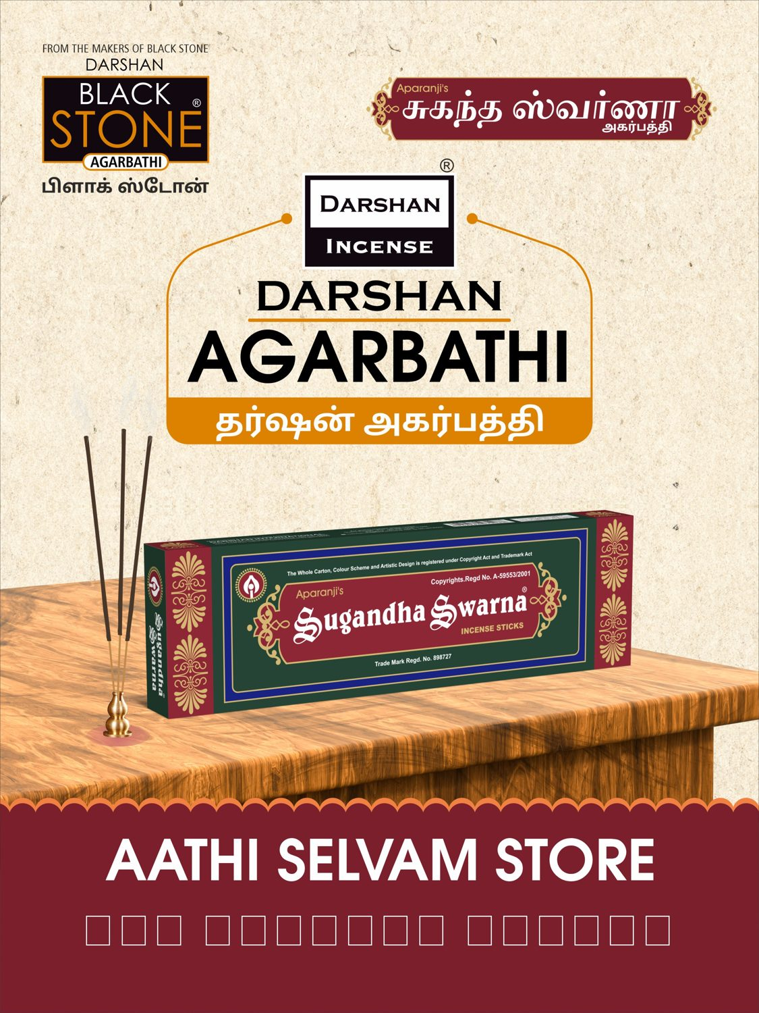
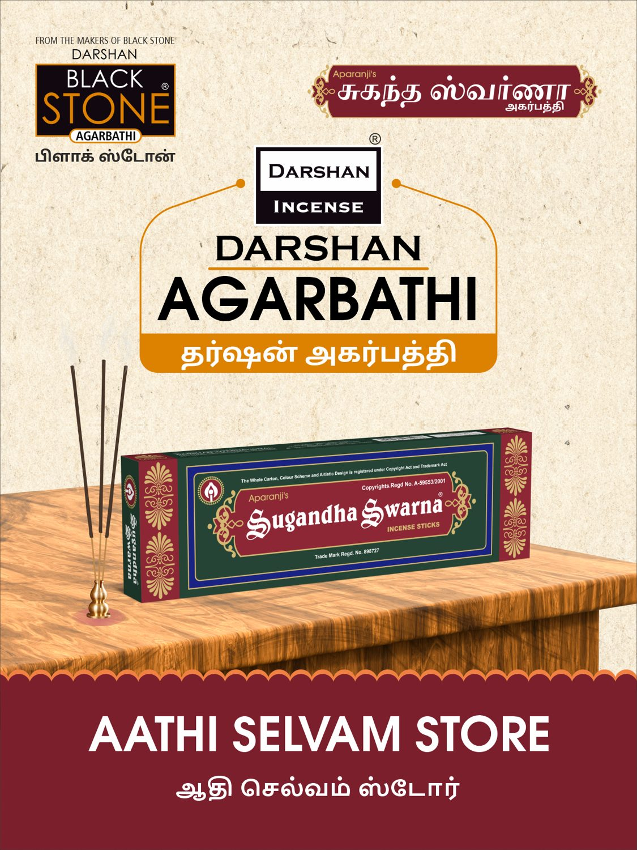
S.No 27
AATHI SELVAM STORE
3 X 4 Feet - Nonlit
VERY CLOSE (98 %)
Name check: OK
DESIGNER
AUTOMATED

Slide 38
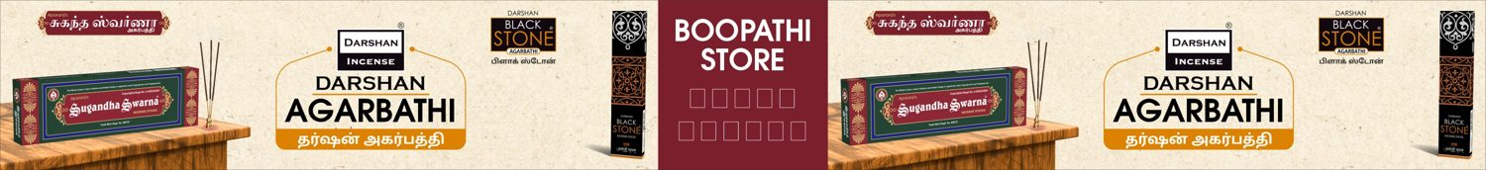
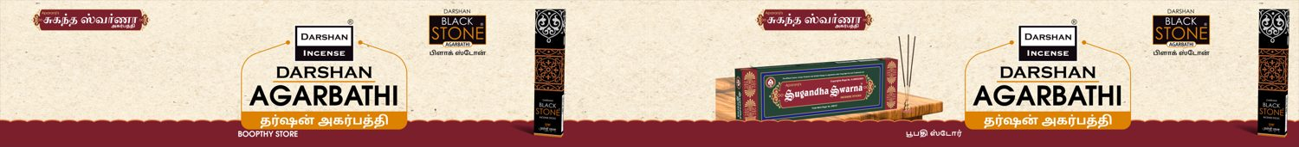
S.No 31
BOOPTHY STORE
35 X 4 Feet - Nonlit
DIFFERENT (83 %)
Name check: OK
DESIGNER
AUTOMATED

Slide 39
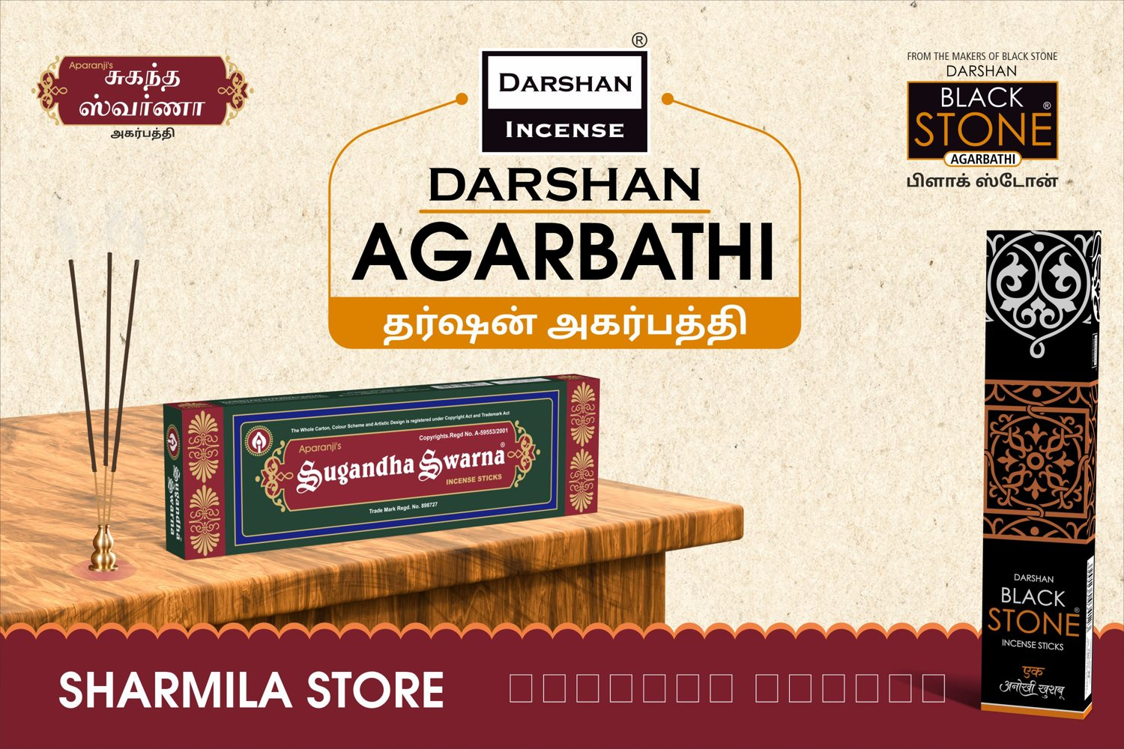
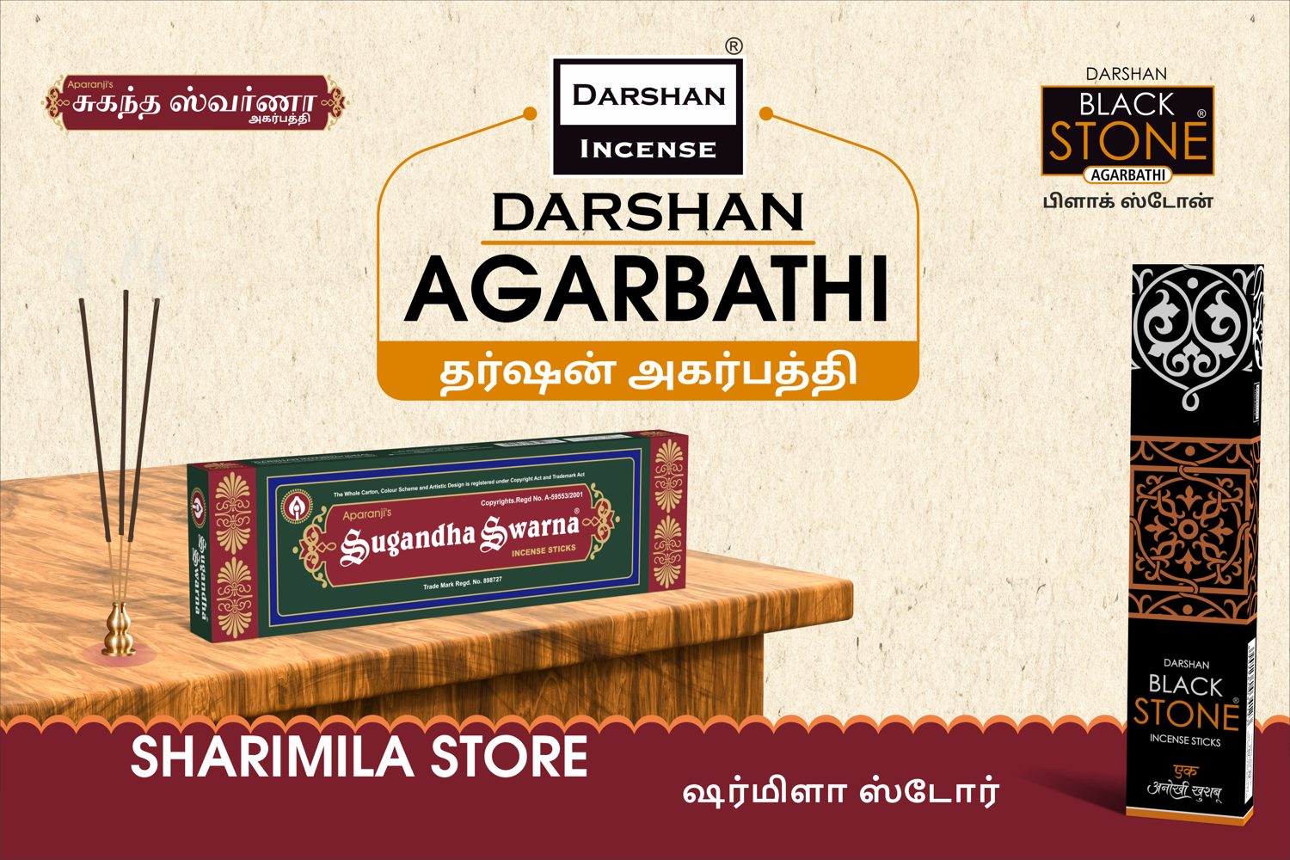
S.No 32
SHARIMILA STORE
6 X 4 Feet - Nonlit
VERY CLOSE (96 %)
Name check: OK
DESIGNER
AUTOMATED

